Slide 1
Chapter Thirteen
Network Design and Management
Data Communications and Computer Networks: A Business User’s Approach
Eighth Edition

Slide 2
After reading this chapter, you should be able to:
Recognize the systems development life cycle and define each of its phases
Explain the importance of creating one or more connectivity maps
Outline the differences among technical, financial, operational, and time feasibility
Create a cost-benefit analysis incorporating the time value of money
Explain why performing capacity planning and traffic analysis is difficult
Data Communications and Computer Networks: A Business User's Approach, Eighth Edition
© 2016. Cengage Learning. All Rights Reserved.

Slide 3
After reading this chapter, you should be able to (continued):
Describe the steps involved in performing a baseline study
Discuss the importance of a network administrator and the skills required for that position
Calculate component and system reliability and availability
Recognize the basic hardware and software network diagnostic tools
Describe the importance of a help desk with respect to managing network operations
Data Communications and Computer Networks: A Business User's Approach, Eighth Edition
© 2016. Cengage Learning. All Rights Reserved.

Slide 4
After reading this chapter, you should be able to (continued):
List the main features of the Simple Network Management Protocol (SNMP) and distinguish between a manager and an agent
Describe the use of the Remote Network Monitoring (RMON) protocol and its relationship to SNMP
Data Communications and Computer Networks: A Business User's Approach, Eighth Edition
© 2016. Cengage Learning. All Rights Reserved.

Slide 5
Introduction
Properly designing a computer network is difficult task
  It requires planning and analysis, feasibility studies, capacity planning, and baseline creation skills
Performing network management is difficult too
  Network manager must possess computer and people skills, management skills, financial skills, and be able to keep up with changing technology
Data Communications and Computer Networks: A Business User's Approach, Eighth Edition
© 2016. Cengage Learning. All Rights Reserved.

Slide 6
Systems Development Life Cycle
Every business has number of goals
  System planners and management personnel within company try to generate set of questions, or problems, to help company achieve those goals
To properly understand a problem, analyze all possible solutions, select the best solution, and implement and maintain the solution, you need to follow a well-defined plan
  SDLC is a methodology, or plan, for a structured approach to the development of a business system
Data Communications and Computer Networks: A Business User's Approach, Eighth Edition
© 2016. Cengage Learning. All Rights Reserved.

Slide 7
Systems Development Life Cycle (continued)
SDLC involves several phases which are:
  Planning
  Analysis
  Design
  Implementation
  Maintenance
These phases are cyclical and usually never-ending
Data Communications and Computer Networks: A Business User's Approach, Eighth Edition
© 2016. Cengage Learning. All Rights Reserved.

Slide 8
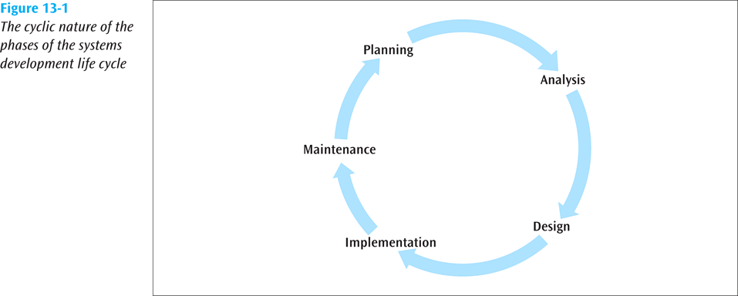
Systems Development Life Cycle (continued)
Data Communications and Computer Networks: A Business User's Approach, Eighth Edition
© 2016. Cengage Learning. All Rights Reserved.

Slide 9
Systems Development Life Cycle (continued)
Systems analyst is typically responsible for managing a project and following the SDLC phases
Anyone, however, may be called upon to assist a systems analyst
  Or anyone may have to assume some duties of systems analyst
Individuals that are called upon to support a computer network should understand basic phases of SDLC
Data Communications and Computer Networks: A Business User's Approach, Eighth Edition
© 2016. Cengage Learning. All Rights Reserved.

Slide 10
Systems Development Life Cycle (continued)
Planning Phase
  Identify problems, opportunities, and objectives
Analysis Phase
  Determine information requirements
      Information requirements can be gathered by sampling and collecting hard data, interviewing, questionnaires, observing environments, and prototyping
Design Phase
  Design the system that was recommended and approved at the end of the analysis phase
Data Communications and Computer Networks: A Business User's Approach, Eighth Edition
© 2016. Cengage Learning. All Rights Reserved.

Slide 11
Systems Development Life Cycle (continued)
Implementation Phase
  The system is installed and preparations are made to move from the old system to the new
Maintenance Phase
  The longest phase, involves the ongoing maintenance of the project
  May require personnel to return to an earlier phase to perform an update
Data Communications and Computer Networks: A Business User's Approach, Eighth Edition
© 2016. Cengage Learning. All Rights Reserved.

Slide 12
Network Modeling
When updating or creating a new computer system, analyst will create set of models for both existing system and proposed system
Network models can either:
  Demonstrate current state of network
  Model desired computer network
Series of connectivity maps are network modeling tools that depict various locations involved over wide and local areas and interconnections between those locations
Data Communications and Computer Networks: A Business User's Approach, Eighth Edition
© 2016. Cengage Learning. All Rights Reserved.

Slide 13
Wide Area Connectivity Map
Shows big picture of geographic locations of network facilities
External users and mobile users can be identified, as well as the locations primary to a business
Data Communications and Computer Networks: A Business User's Approach, Eighth Edition
© 2016. Cengage Learning. All Rights Reserved.

Slide 14
Wide Area Connectivity Map (continued)
To identify each connection between sites:
  d = distance of the connection (usually shown in either miles or kilometers)
  s = security level (high, medium, low, or none)
  du = duplexity (full duplex, half duplex, or simplex)
  dr = data rate desired (in bps)
  l = latency, or acceptable delay time across the network (usually in milliseconds, or ms)
  QoS = Quality of Service
    CBR - constant bit rate, VBR - variable bit rate, ABR - available bit rate, UBR - unreliable bit rate, or none
  de = delivery rate (sometimes called throughput percentage)
Data Communications and Computer Networks: A Business User's Approach, Eighth Edition
© 2016. Cengage Learning. All Rights Reserved.

Slide 15
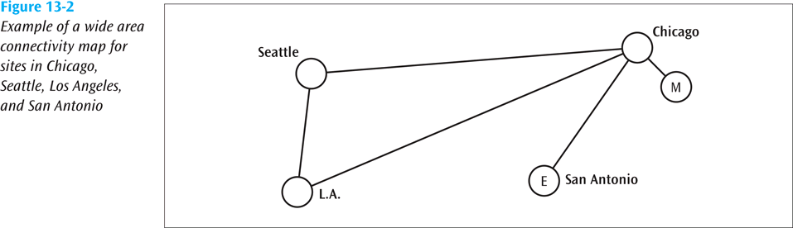
Wide Area Connectivity Map (continued)
Data Communications and Computer Networks: A Business User's Approach, Eighth Edition
© 2016. Cengage Learning. All Rights Reserved.

Slide 16
Wide Area Connectivity Map (continued)
Connection from L.A. to Chicago might be:
  d = 2250 miles
  s = medium
  du = full
  dr = 256 kbps
  l = 200 ms
  QoS = ABR
  de = 99.9%
Data Communications and Computer Networks: A Business User's Approach, Eighth Edition
© 2016. Cengage Learning. All Rights Reserved.

Slide 17
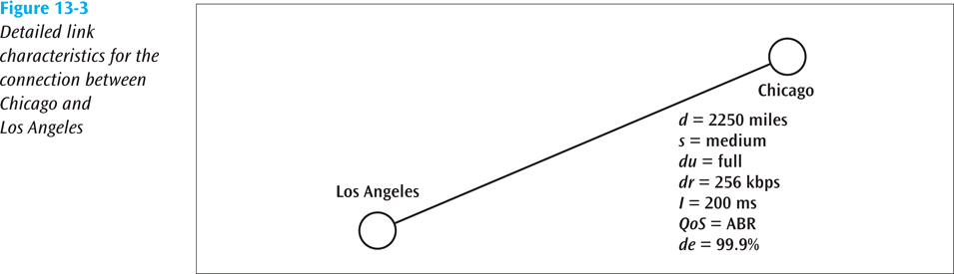
Wide Area Connectivity Map (continued)
Data Communications and Computer Networks: A Business User's Approach, Eighth Edition
© 2016. Cengage Learning. All Rights Reserved.

Slide 18
Metropolitan Area Connectivity Map
Shows the design of a metropolitan area and its network facilities.
QoS = VBR
dr = 100 Mbps
s = high
d = 5 km
failover = 50 ms
de = 99.9%
Data Communications and Computer Networks: A Business User's Approach, Eighth Edition
© 2016. Cengage Learning. All Rights Reserved.

Slide 19
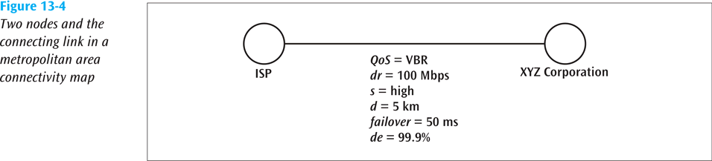
Metropolitan Area Connectivity Map (continued)
Data Communications and Computer Networks: A Business User's Approach, Eighth Edition
© 2016. Cengage Learning. All Rights Reserved.

Slide 20
Local Area Connectivity Map
Local area overview connectivity map – shows the big picture design of a local area network
  QoS = none
  dr = 100 Mbps
  s = none
  d = 85 m
  du = full
  thru = 50%
Data Communications and Computer Networks: A Business User's Approach, Eighth Edition
© 2016. Cengage Learning. All Rights Reserved.

Slide 21
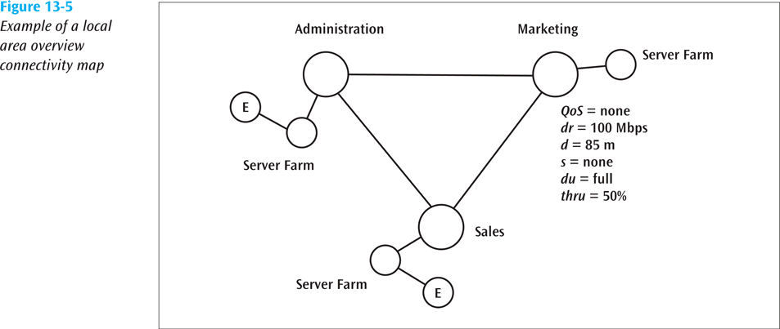
Local Area Connectivity Map (continued)
Data Communications and Computer Networks: A Business User's Approach, Eighth Edition
© 2016. Cengage Learning. All Rights Reserved.

Slide 22
Local Area Connectivity Map (continued)
Local area detailed connectivity map – shows the close-up design of a local area network, including switches, routers, hubs, and servers
  Much like the homework we did earlier showing LAN connections
Data Communications and Computer Networks: A Business User's Approach, Eighth Edition
© 2016. Cengage Learning. All Rights Reserved.

Slide 23
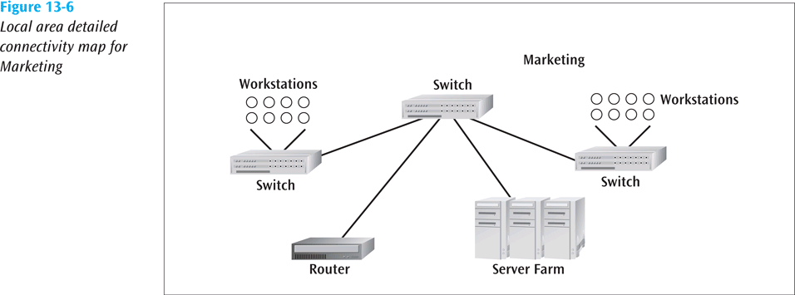
Local Area Connectivity Map (continued)
Data Communications and Computer Networks: A Business User's Approach, Eighth Edition
© 2016. Cengage Learning. All Rights Reserved.

Slide 24
Feasibility Studies
There are a number of ways to determine if a proposed system is going to be feasible
Technically feasible – proposed system can be created and implemented using currently existing technology
Financially feasible – proposed system can be built given the company’s current financial ability
Operationally feasible – system operates as designed and implemented
Data Communications and Computer Networks: A Business User's Approach, Eighth Edition
© 2016. Cengage Learning. All Rights Reserved.

Slide 25
Feasibility Studies (continued)
Time feasible – system can be constructed in an agreed upon time frame
Payback analysis is good technique to use to determine financial feasibility
  To calculate payback analysis, you must know all expenses that will be incurred to create and maintain system, as well as all possible income derived from system
  You must also be aware of time value of money
    A dollar today is worth more than one dollar promised a year from now because dollar can be invested
Data Communications and Computer Networks: A Business User's Approach, Eighth Edition
© 2016. Cengage Learning. All Rights Reserved.

Slide 26
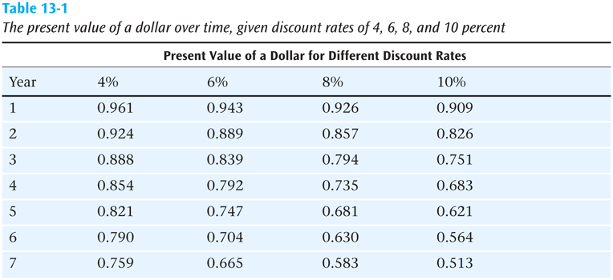
Feasibility Studies (continued)
Data Communications and Computer Networks: A Business User's Approach, Eighth Edition
© 2016. Cengage Learning. All Rights Reserved.

Slide 27
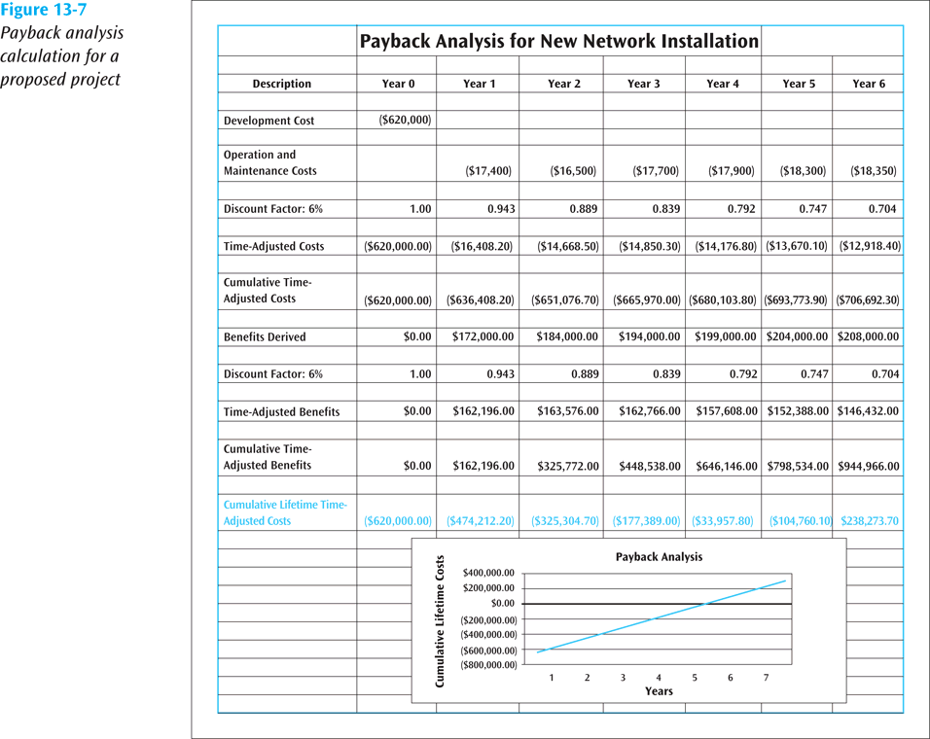
Feasibility Studies (continued)

Slide 28
Capacity Planning
Involves trying to determine the amount of network bandwidth necessary to support an application or a set of applications
A number of techniques exist for performing capacity planning, including linear projection, computer simulation, benchmarking, and analytical modeling
Linear projection involves predicting one or more network capacities based on the current network parameters and multiplying by some constant
Data Communications and Computer Networks: A Business User's Approach, Eighth Edition
© 2016. Cengage Learning. All Rights Reserved.

Slide 29
Capacity Planning (continued)
A computer simulation involves modeling an existing system or proposed system using a computer-based simulation tool
Benchmarking involves generating system statistics under a controlled environment and then comparing those statistics against known measurements
Analytical modeling involves the creation of mathematical equations to calculate various network values
Data Communications and Computer Networks: A Business User's Approach, Eighth Edition
© 2016. Cengage Learning. All Rights Reserved.

Slide 30
Creating a Baseline
Involves measurement and recording of a network’s state of operation over given period of time
Baseline can be used to determine current network performance and to help determine future network needs
Baseline studies should be ongoing projects, and not something started and stopped every so many years
Data Communications and Computer Networks: A Business User's Approach, Eighth Edition
© 2016. Cengage Learning. All Rights Reserved.

Slide 31
Creating a Baseline (continued)
To perform a baseline study, you should:
  Collect information on number and type of system nodes, including workstations, routers, bridges, switches, hubs, and servers
  Create an up-to-date roadmap of all nodes along with model numbers, serial numbers and any address information such as IP or Ethernet addresses
  Collect information on operational protocols used throughout the system
Data Communications and Computer Networks: A Business User's Approach, Eighth Edition
© 2016. Cengage Learning. All Rights Reserved.

Slide 32
Creating a Baseline (continued)
To perform a baseline study, you should: (continued)
  List all network applications, including the number, type and utilization level
  Create a fairly extensive list of statistics to help meet your goals
    These statistics can include average network utilization, peak network utilization, average frame size, peak frame size, average frames per second, peak frames per second, total network collisions, network collisions per second, total runts, total jabbers, total CRC errors, and nodes with highest percentage of utilization
Data Communications and Computer Networks: A Business User's Approach, Eighth Edition
© 2016. Cengage Learning. All Rights Reserved.

Slide 33
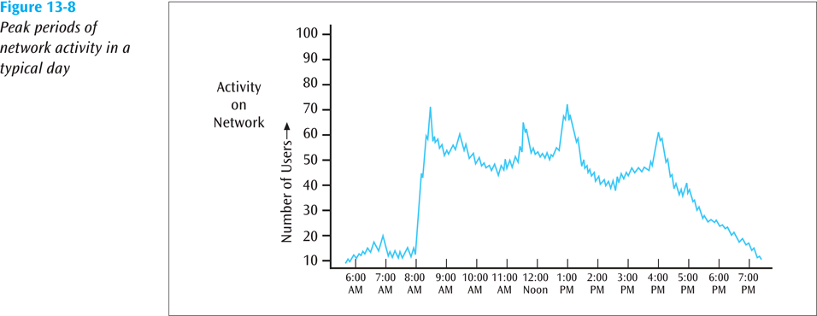
Creating a Baseline (continued)
Data Communications and Computer Networks: A Business User's Approach, Eighth Edition
© 2016. Cengage Learning. All Rights Reserved.

Slide 34
Network Administrator Skills
A good network manager will possess many skills:
  Computer skills
  People skills
  Management skills
  Financial planning skills
  Knowledge of statistics
  Speaking and writing skills
Data Communications and Computer Networks: A Business User's Approach, Eighth Edition
© 2016. Cengage Learning. All Rights Reserved.

Slide 35
Network Administrator Skills (continued)
A good network manager will possess one or more certifications:
  Microsoft Certified Solutions Associate (MCSA)
  Cisco Certified Network Associate (CCNA)
  IBM Certified Systems Expert (CSE)
  And others
Data Communications and Computer Networks: A Business User's Approach, Eighth Edition
© 2016. Cengage Learning. All Rights Reserved.

Slide 36
Generating Usable Statistics
Statistics, properly generated, can be an invaluable aid to demonstrating current system demands and predicting future needs
Mean time between failures (MTBF) – average time a device or system will operate before it fails
Mean time to repair (MTTR) – average time necessary to repair a failure within the computer system
Data Communications and Computer Networks: A Business User's Approach, Eighth Edition
© 2016. Cengage Learning. All Rights Reserved.

Slide 37
Generating Usable Statistics (continued)
Availability – probability that a particular component or system will be available during a fixed time period
Availability % =
  (Total available time – Downtime) / Total available time
Data Communications and Computer Networks: A Business User's Approach, Eighth Edition
© 2016. Cengage Learning. All Rights Reserved.

Slide 38
Generating Usable Statistics (continued)
Suppose we want to calculate the availability of a modem for one month (24 hours per day for 30 days, or 720 hours), knowing the modem will be down for two hours during that period:
  Availability % = (720 – 2) / 720
        = 0.997
Data Communications and Computer Networks: A Business User's Approach, Eighth Edition
© 2016. Cengage Learning. All Rights Reserved.

Slide 39
Generating Usable Statistics (continued)
Reliability is defined by the equation:
    R(t) = e ^{-bt}
  In which: b = 1/MTBF
    t = the time interval of the operation
Data Communications and Computer Networks: A Business User's Approach, Eighth Edition
© 2016. Cengage Learning. All Rights Reserved.

Slide 40
Generating Usable Statistics (continued)
What is the reliability of a modem if the MTBF is 3000 hours and a transaction takes 20 minutes, or 1/3 of an hour (0.333 hours):
  R(0.333 hours) = e ^{-(1/3000)*(0.333)}
    = e ^{-0.000111}
    = 0.99989
Data Communications and Computer Networks: A Business User's Approach, Eighth Edition
© 2016. Cengage Learning. All Rights Reserved.

Slide 41
Managing Operations
There are many services and functions available to assist an individual in managing computer network operations
  One of the more useful is Simple Network Management Protocol (SNMP)
SNMP is industry standard designed to manage network components from a remote location
  Currently in version 3, SNMP supports agents, managers, and the Management Information Base (MIB)
Data Communications and Computer Networks: A Business User's Approach, Eighth Edition
© 2016. Cengage Learning. All Rights Reserved.

Slide 42
Managing Operations (continued)
A managed element has management software, called an agent, running in it
A second object, SNMP manager, controls operations of a managed element and maintains a database of information about all managed elements
A manager can query an agent to return current operating values, or can instruct an agent to perform a particular action
Management Information Base (MIB) – collection of information that is organized hierarchically and describes the operating parameters of all managed agents
Data Communications and Computer Networks: A Business User's Approach, Eighth Edition
© 2016. Cengage Learning. All Rights Reserved.

Slide 43
Network Diagnostic Tools
To assist a network support person, a number of diagnostic tools are available:
  Electrical testers
  Cable testers
  Network testers
  Protocol analyzers
Data Communications and Computer Networks: A Business User's Approach, Eighth Edition
© 2016. Cengage Learning. All Rights Reserved.

Slide 44
Capacity Planning and Network Design
In Action: Better Box Corporation
Returning to Better Box Corporation from an earlier chapter, let’s complete our design, including e-mail and Internet access for each of the four sites
A linear projection can be used to estimate the amount of Internet traffic at each site
A wide area connectivity map gives us a big picture of the network interconnections
Data Communications and Computer Networks: A Business User's Approach, Eighth Edition
© 2016. Cengage Learning. All Rights Reserved.

Slide 45
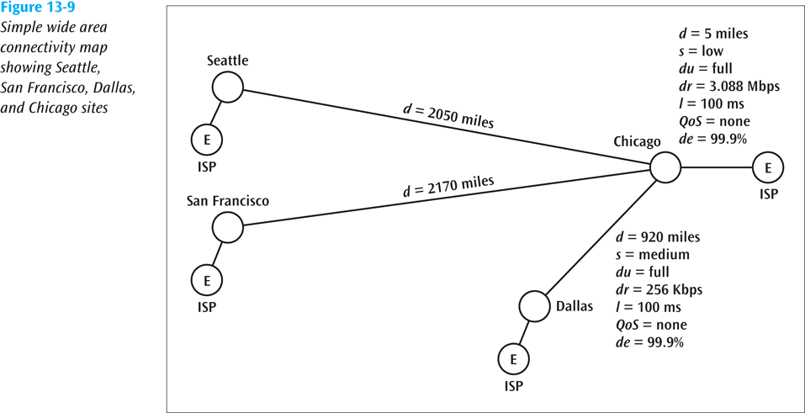
Capacity Planning and Network Design
In Action: Better Box Corporation (continued)
Data Communications and Computer Networks: A Business User's Approach, Eighth Edition
© 2016. Cengage Learning. All Rights Reserved.

Slide 46
Capacity Planning and Network Design
In Action: Better Box Corporation (continued)
A second linear projection can be used to determine the amount of local area network traffic within each site
Data Communications and Computer Networks: A Business User's Approach, Eighth Edition
© 2016. Cengage Learning. All Rights Reserved.

Slide 47
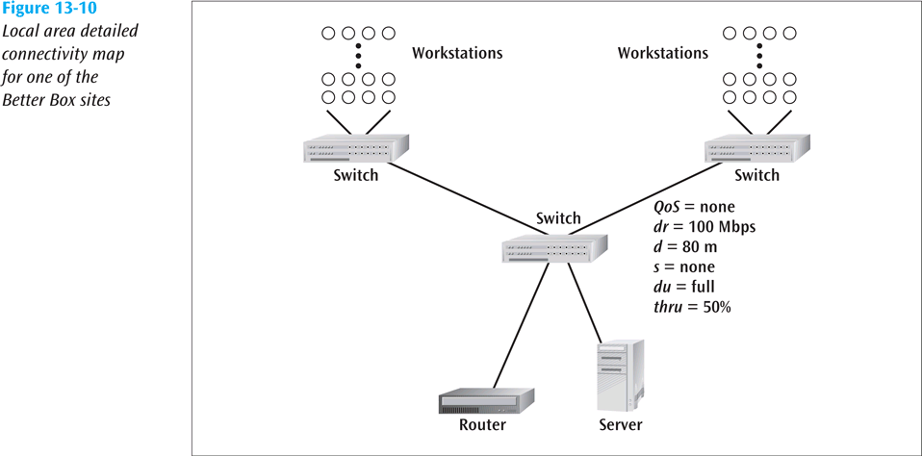
Capacity Planning and Network Design
In Action: Better Box Corporation (continued)
Data Communications and Computer Networks: A Business User's Approach, Eighth Edition
© 2016. Cengage Learning. All Rights Reserved.

Slide 48
Summary
When creating new network or adding to existing network, there are many potential pitfalls and opportunities for inaccurate and incomplete assessments
SDLC is one of the most popular techniques used to guide analysts through difficult decision-making process of network design
Persons designing new network or upgrading existing network may want to create one or more network models to help visualize the system
An important part of SDLC is conducting of one or more feasibility studies
Data Communications and Computer Networks: A Business User's Approach, Eighth Edition
© 2016. Cengage Learning. All Rights Reserved.

Slide 49
Summary (continued)
Payback analysis is one possible financial analysis technique that can be applied to proposed computer network system to determine system’s costs and benefits
Capacity planning is necessary technique that enables network administrator to determine network bandwidth needed to support one or more applications within a business
A baseline study involves measuring and recording of network’s state of operation over a given period of time
Once a network is in operation, good network management is necessary to keep network operating at peak efficiency
Data Communications and Computer Networks: A Business User's Approach, Eighth Edition
© 2016. Cengage Learning. All Rights Reserved.

Slide 50
Summary (continued)
Network administrator should be able to create and use basic statistics
A large variety of diagnostic tools are available that can aid network personnel in troubleshooting and maintaining common complex computer networks
All networks need a command center
The Simple Network Management Protocol (SNMP) helps network support personnel monitor network performance, find network problems, and then solve those problems without physically touching the affected device
Data Communications and Computer Networks: A Business User's Approach, Eighth Edition
© 2016. Cengage Learning. All Rights Reserved.

